Slide 1
IILM UNIVERSITY, GREATER NOIDA
DIABETES DIET ADVISOR
Internship Presentation
Student Details
Internship
KUNAL SHUKLA Enrollment: 25SCS1003003291 B.Tech CSE (AI & ML) | 3rd Semester Section: 2CSE10 | Batch: 2025–2029
AI-Driven Web Application & Product Development Lenovo LEAP NextGen Scholar Program Implemented by BharatCares in association with AICTE 15 June – 30 July 2026
1

Slide 2
Internship Overview
Six-week AICTE internship under Lenovo LEAP NextGen Scholar Program
Format
Learning
Career Exposure
Virtual, project-oriented learning journey
Orientation, 7 masterclasses, mentoring and assessment
Career-readiness sessions and hackathon orientation
Focus: AI-driven web application & product development
Practical web/product development approach
SDG-oriented project thinking
Skill India assessment completed
2

Slide 3
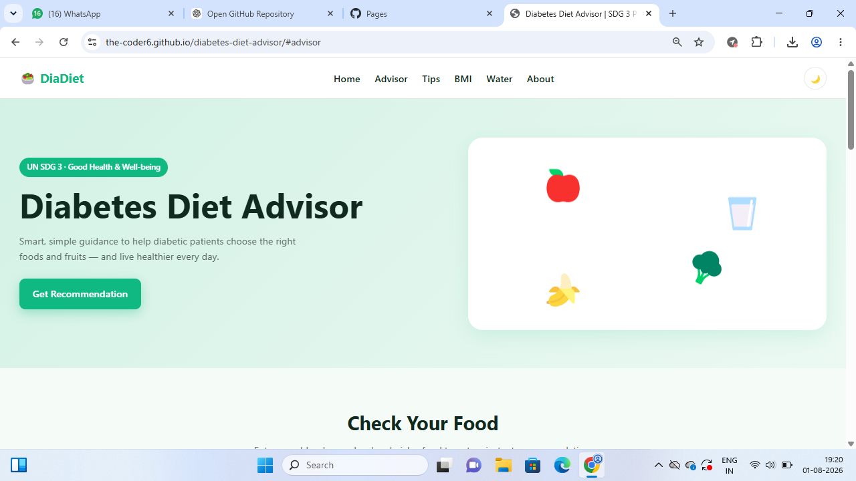
Project: Diabetes Diet Advisor (DiaDiet)
A health and wellness web application aligned with UN SDG 3
Simple food-choice guidance
Blood sugar + food input
Healthy diet tips
BMI calculator
Water-intake tracker
Publicly deployed using GitHub Pages
Live Project
the-coder6.github.io/diabetes-diet-advisor
3

Slide 4
Problem Statement & Objectives
Problem
Objectives
Diabetes-aware dietary information can be scattered or difficult to translate into everyday food choices. The project explores a simple browser-based interface that combines quick food guidance with basic wellness utilities. The application is educational and is not a diagnostic or clinical decision-support system.
• Build a clean responsive web application • Provide quick food recommendation messages • Add BMI and hydration utilities • Apply HTML, CSS and JavaScript • Deploy the project publicly • Align the theme with UN SDG 3 • Document the project honestly and responsibly
4

Slide 5
Technologies & Tools Used
HTML5
CSS3
JavaScript
Page structure, forms, navigation and content
Responsive styling, cards, layout and visual states
Interactive recommendations, BMI and water tracking
GitHub
GitHub Pages
Prompt Engineering
Public source-code repository and version history
Static website deployment
Internship learning topic; not claimed as a runtime AI service
5

Slide 6
System Architecture
Client-side static web application
USER
WEB BROWSER
HTML UI
JAVASCRIPT LOGIC
RESULT
→
→
→
→
CSS Presentation
GitHub Pages Hosting
Supports responsive layout and visual design.
Serves the HTML, CSS and JavaScript files publicly.
6

Slide 7
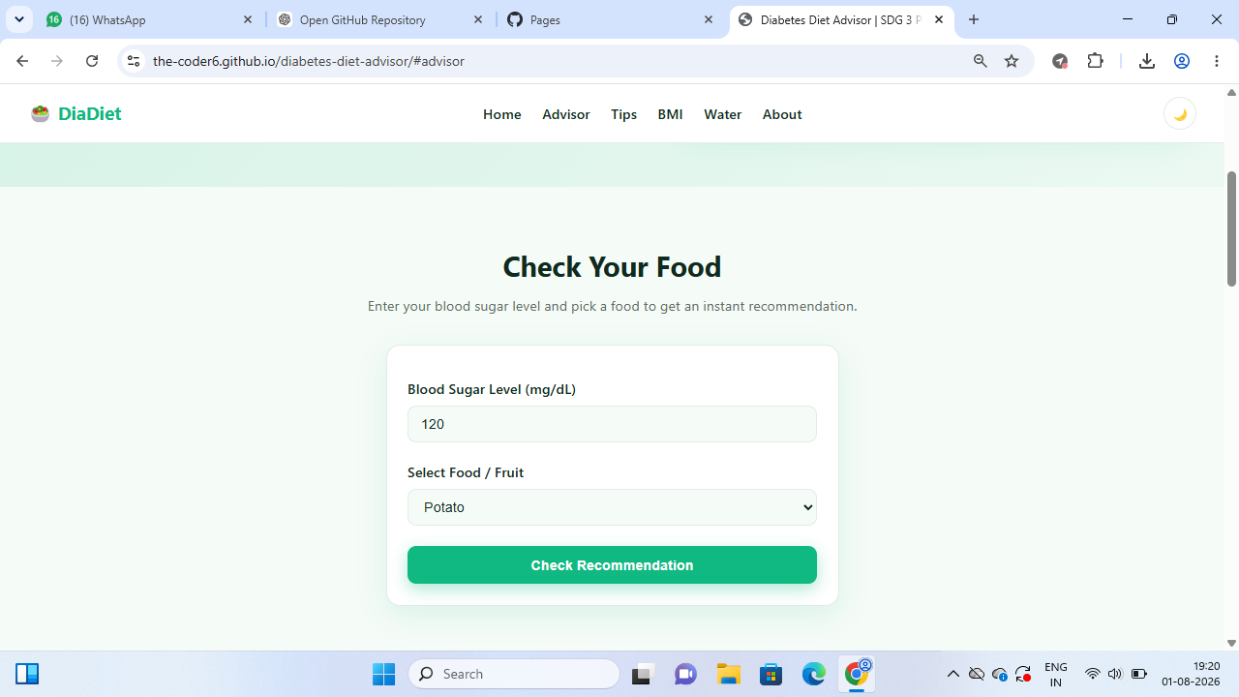
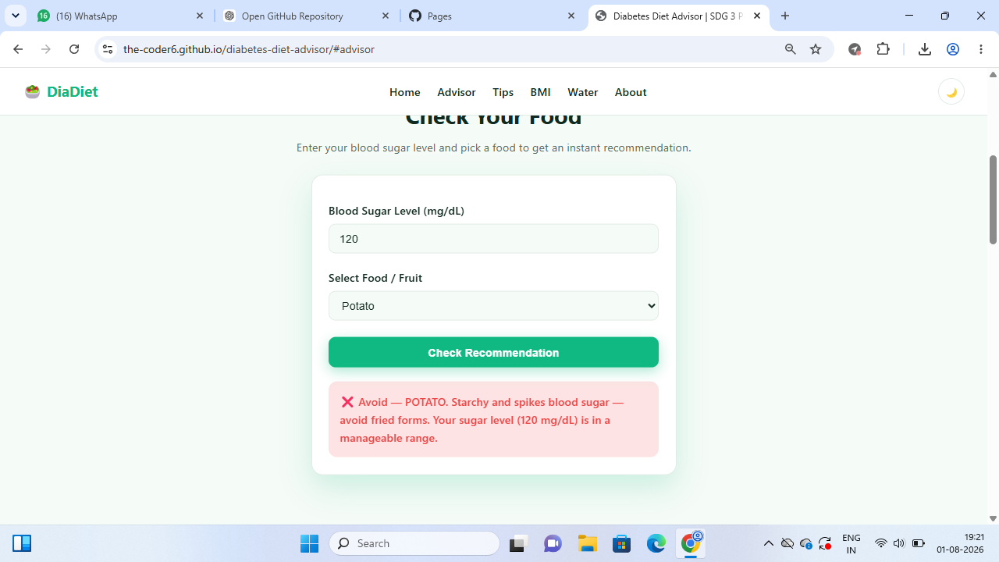
Core Feature: Food Advisor
How it works
User enters a blood sugar value and selects a food/fruit. JavaScript applies simple rule-based logic and displays an immediate educational recommendation. No trained ML model or external AI API is claimed in the current implementation.
7

Slide 8
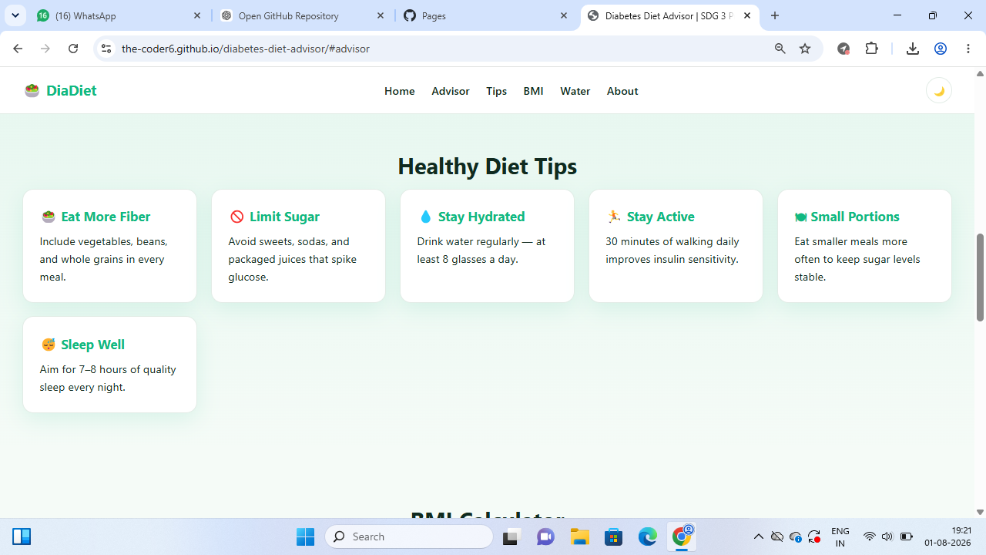
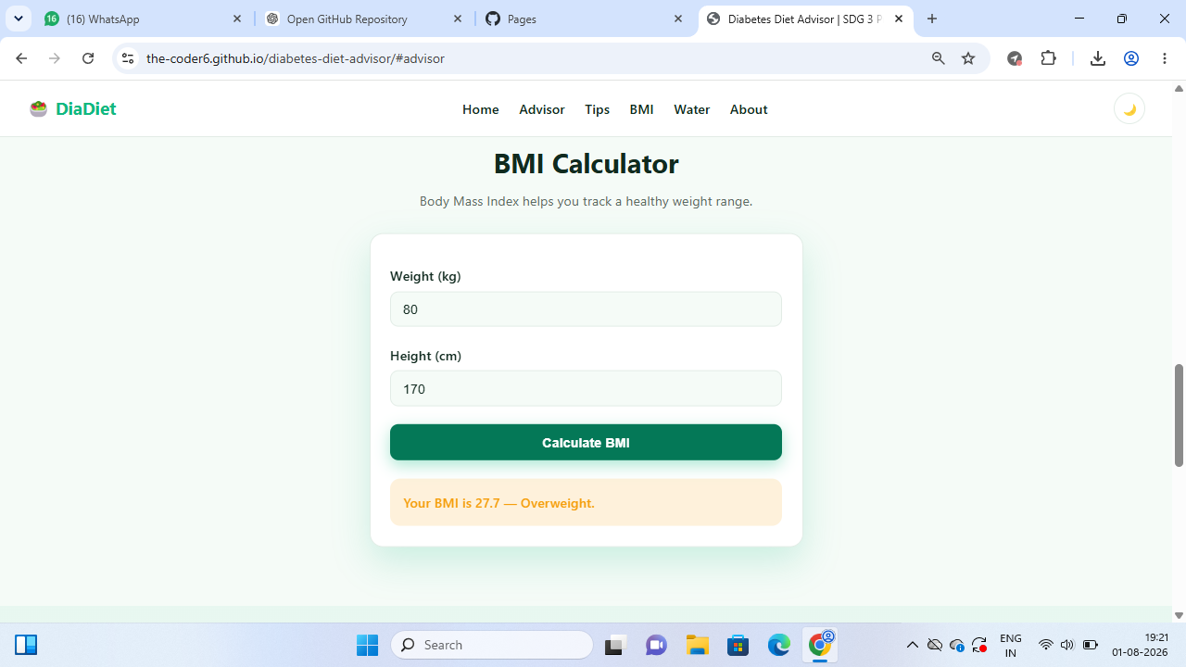
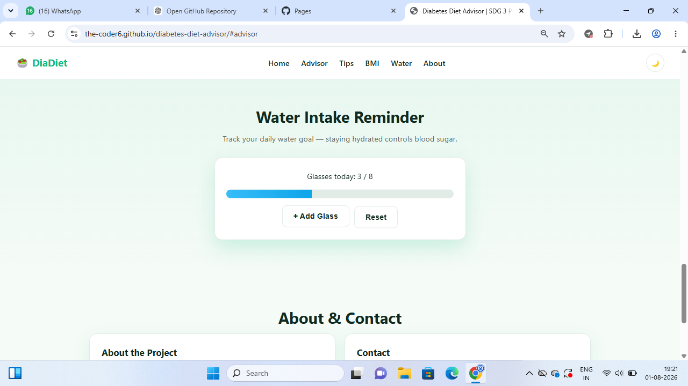
Supporting Wellness Features
Healthy Diet Tips
BMI Calculator
Water Tracker
Short cards on fiber, sugar, hydration, activity, portions and sleep.
Calculates BMI from height and weight and displays a category.
Tracks progress toward the displayed daily hydration goal.
8

Slide 9
Development Methodology
1. Problem Selection
2. Requirements
3. UI Design
Health & wellness theme + SDG 3
Advisor + wellness utilities
Single-page responsive navigation
4. Implementation
5. Testing
6. Deployment
HTML + CSS + JavaScript
Browser testing of interactions
GitHub repository + GitHub Pages
9

Slide 10
Project Outcomes & Internship Learning
Project Outcomes
Internship Learning
• Working public web application • Food-advisor interaction • BMI calculator • Water-intake tracker • Responsive health-oriented UI • GitHub source repository • GitHub Pages deployment • SDG 3 alignment
• Product-oriented development workflow • Prompt engineering concepts • Masterclass and mentoring exposure • Project planning and implementation • Assessment participation • Career-readiness exposure • Documentation and presentation skills
10

Slide 11
Limitations & Future Scope
Current recommendations are rule-based and educational.
No clinical diagnosis, prescription or individualized medical treatment.
Future version can use validated nutrition datasets.
Add persistent user profiles and secure backend services.
Improve accessibility and automated testing.
AI/ML personalization should be added only with validated data and appropriate safety review.
Responsible Scope
The project demonstrates web development and health-awareness product design; it does not replace professional medical advice.
11

Slide 12
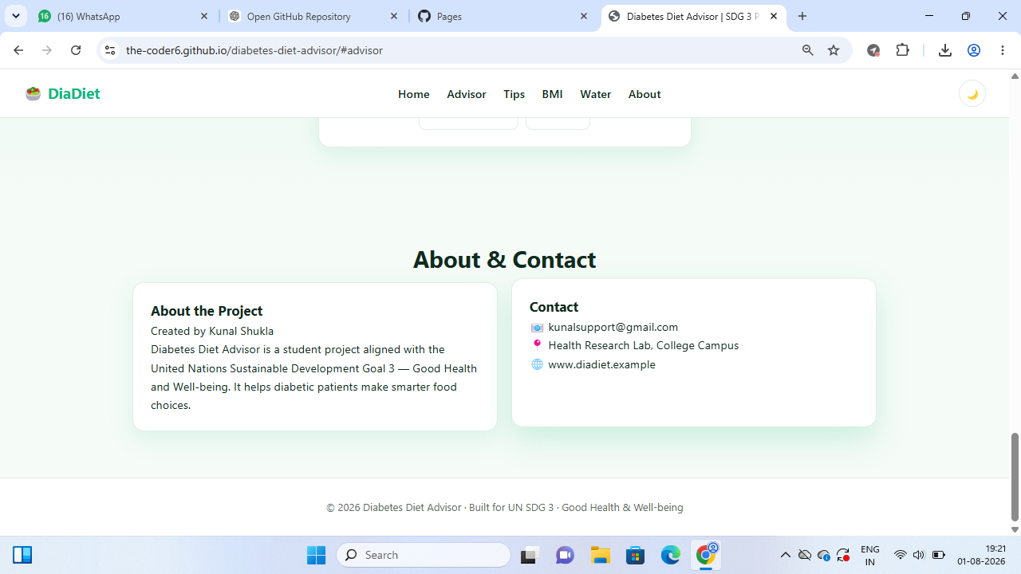
Conclusion
DiaDiet converts an SDG-oriented idea into a working web product.
The project demonstrates front-end development and interactive JavaScript.
The internship provided structured masterclass, mentoring and assessment exposure.
The application is publicly accessible and supported by a public source repository.
Repository
github.com/the-coder6/diabetes-diet-advisor
12

Slide 13
THANK YOU
KUNAL SHUKLA | 25SCS1003003291 | 2CSE10 | B.Tech CSE AI&ML

